Slide 1
L 3. Ability models, Trait models, Mixed model, development of EI
Tyulkubayeva A.K.

Slide 2
Different theorists defined emotional intelligence differently and theorist like Bar-On, Goleman and Petrides categorised emotional intelligence as a non-cognitive except Salovey and Mayer, the pioneer of emotional intelligence.
Salovey and Mayer (1990) defined emotional intelligence as “the ability to monitor one’s own and other’s emotions, to discriminate among them and to use the information to guide one’s thinking and actions”
Goleman (1995) on the other hand explained that emotional intelligence is any underlying personal characteristic that is not represented by cognitive intelligence.
Bar-On viewed emotional intelligence as non-cognitive capabilities, competencies, and skills that influence an individual’s ability to cope with environmental demands and pressures successfully (Bar-On, 1997).
Petrides and Furnham (2001) defined emotional intelligence as a trait and it is a constellation of emotional self-perceptions located at the lower levels of personality hierarchies.

Slide 3
These various definitions of emotional intelligence have contributed to the development of three emotional intelligence models:
(1) ability model
(2) mixed model
(3) trait model
Generally, the existing models have described emotional intelligence as personal intelligence (understanding, managing and utilising emotion in oneself) and social intelligence (understanding and managing emotion in others). Variation in definitions of emotional intelligence proposed by major theorists contributed to the development of various emotional intelligence models.

Slide 4
ABILITY MODEL OF EMOTIONAL INTELLIGENCE
Ability model of emotional intelligence is made up of four sets of emotion processing mental abilities, which arranged in the order from very basic to higher-level ability.
Mayer and Salovey’s (1997) model comprised of ability namely
(1) perception, appraisal and expression of emotion,
(2) emotional facilitation of thinking,
(3) understanding and analysing emotions, and
(4) reflective regulation of emotions.
Each group of the ability has four levels that ranged from the very basic level to the highest advanced level. Mayer and Salovey (1997) described perception, appraisal, and expression of emotion dimension as the ability to identify and differentiate emotion in oneself and in others.

Slide 5
(1) perception, appraisal and expression of emotion
The process of perception, appraisal, and expression of emotion starts with ability to identify one’s own emotions via body arousal, inner feelings, and thoughts. Subsequently, as an individual mastered in generalising emotions based on their self-experience, the ability to identify others’ emotion by observing surrounding cues develops. Following that, an individual could express feelings coherently to the surrounding cues. Finally, an individual can differentiate between accurate and inaccurate expressions of feelings, as well as recognise or ascertain between honest and dishonest expressions of feelings.

Slide 6
(2) emotional facilitation of thinking
Another dimension of emotional intelligence in ability model is emotional facilitation of thinking dimension (Mayer & Salovey, 1997). Emotional facilitation of thinking dimension is described as the ability to use emotion in facilitating the thinking processes such as reasoning, problem-solving, and interpersonal communication. At the basic level, an individual will use emotions to prioritise thinking by focusing on important information in their surrounding environment. Eventually, an individual can generate vivid emotions to aid judgments and memory process. An individual will feel, manipulate, and examine the generated emotion deeply to plan or make a decision. Once then, an individual can think from various perspectives by utilising their emotional mood swing. Specifically, bad mood leads to pessimistic thoughts while good mood leads to optimistic thoughts. As the mood swings, thinking style will shift too. Hence, an emotionally intelligent persons tend to be more flexible while constructing a plan as they use emotional mood swing ability (Mayer & Salovey, 1997; Salovey & Mayer, 1990). The highest level in emotional facilitation of thinking dimension is the ability to recognise reasoning induced by the emotion. Happiness (emotional state) facilitates creative and inductive reasoning while sadness (emotional state) facilitates deductive reasoning.

Slide 7
(3) understanding and analysing emotions
The third dimension, understanding and analysing emotions, explains an individual’s ability to classify emotions and understand meanings implied by those emotions (Mayer & Salovey, 1997). Labelling emotions and recognising similarities and differences between the emotions labelled is fundamental for understanding emotion. For instant, joy is an emotion of great delight or happiness meanwhile, sadness is an aversion emotion that makes us wants to cry and withdraw ourselves from the surroundings (Reeve, 2009). Succeeding that level, leads to the ability to interpret the emotion and its origin, like sadness accompanied a loss; happiness accompanied gain. Once then, the person can understand the complex feelings or blended feelings at a time, such as simultaneous feelings of love and hate. Finally, an individual mastered in understanding and analysing emotions, able to recognise transitions between emotions. For instant, anger can be a shame or satisfaction based on the circumstances of a situation.

Slide 8
(4) reflective regulation of emotions
The last dimension, reflective regulation of emotion dimension is the ability to prevent, reduce, enhance, or modify our own and others’ emotion (Mayer & Salovey, 1997). This encourages cognitive and emotional growth of an individual. In fact, good regulation of emotion, facilitate thinking processes to plan. Basically, individual with a good reflective regulation of emotions tend to accept both pleasant and unpleasant feelings. Eventually, they learn to engage or detach from an emotion based on its utility. Subsequently, the individual could monitor and reflect one’s own and others’ emotions. Finally, the individual will become proficient in managing their emotions by enhancing pleasant emotions and moderating unpleasant emotions.

Slide 9
The ability model is the most influential model as it purely uses cognitive ability in processing emotions and scientifically proven. Furthermore, Mayer and Salovey (1997) argued that emotional intelligence is ability based and not a trait (consistent behaviour over time) as it increases by age and training (Goleman, 1995; Mayer & Salovey, 1997). Additionally, Cherniss (2010) stated that the best model of emotional intelligence is ability model as it follows the common definition of emotional intelligence, “managing emotion in oneself and in others” which also agreed by other major theorists including Petrides, Goleman and Bar-On. In this perceptive, O’Boyle, Humphrey, Pollack, Hawver, and Story (2011) agreed that instruments based on ability model are the best as it has the capability to differentiate emotional intelligence from related variables such as personality and other competencies. Therefore, in this study, the ability model and instrument developed based on ability model was used to describe the phenomena as it emphases the pure form of emotional intelligence excluding trait.

Slide 10
MIXED MODEL OF EMOTIONAL INTELLIGENCE
Mixed model of emotional intelligence enjoys the goodness of both
competency (ability) and
general disposition (trait).
There are two big mixed models of emotional intelligence proposed by
Bar-On (Bar-On, 1997)
Goleman (2001) respectively.
Basically, Bar-On’s mixed model is more theoretical, meanwhile Goleman’s mixed model is more to practical.

Slide 11
Bar-On’s mixed model
Bar-On (1997) is viewed emotional intelligence as non-cognitive capabilities, competencies, and skills that influence an individual’s ability to cope successfully with environmental demands and pressures (Bar-On, 1997). The original model has five dimensions with 15 components. Intrapersonal skills comprise self-regard, emotional selfawareness, assertiveness, self-actualisation, and independence, while interpersonal skills consist of empathy, interpersonal relationship, and social responsibility were described in the first and second dimensions, respectively. This is then followed by adaptability dimension that includes problem-solving, flexibility, and reality testing. The fourth dimension is stress management comprises stress tolerance and impulse control. In the last dimension, general mood such as happiness and optimism were explained. In 2000, Bar-On (2000) refined his original model by re-categorising the components into constituent components (self-regard, emotional self-awareness, assertiveness, empathy, interpersonal relationship, problemsolving, flexibility, reality testing, stress tolerance; impulse control) and facilitators (selfactualisation, independence, social responsibility, optimism; happiness).

Slide 12
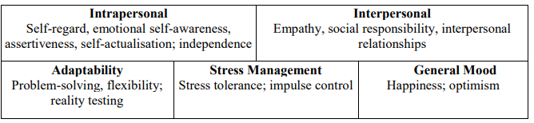
Components in Bar-On’s mixed model of emotional intelligence

Slide 13
Goleman’s mixed model
Goleman (1995) explained that emotional intelligence is any underlying personal characteristic that is not represented by cognitive intelligence. The initial model comprises five dimensions with twenty-five emotional intelligence competencies (Goleman, 1998). First dimension is self-awareness whereby an individual is able to recognise his/her emotions, strengths, weaknesses, goals, motivations, and impact of their emotion on others. Second dimension is self-regulation that includes recognising, control, and redirects their negative emotions into more productive or positive purpose. Third dimension is social skills, which include managing relationships with others and directing others. Fourth dimension is empathy: considers others’ feeling when making decisions. Last dimension is the motivation, the urge or drive for achievement. Later in 2001, Goleman refined his model into four dimensions with twenty emotional intelligence competencies based on the work by Boyatzis and Rhee (Goleman, 2001). The dimensions in the refined model are self-awareness, selfmanagement, social-awareness; relationship management.

Slide 14
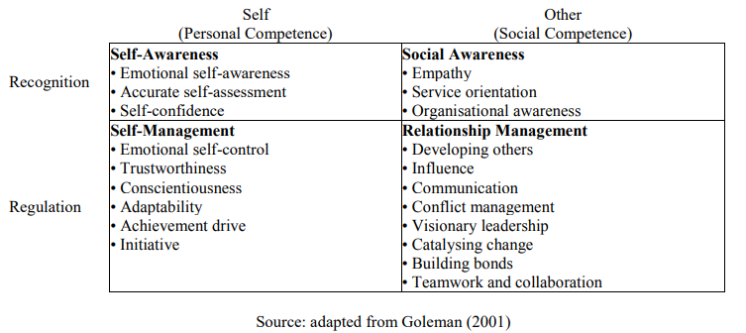
Refined framework of Goleman’s mixed model of emotional intelligence

Slide 15
The problem with mixed model
However, the problem with mixed model is the construct, as it is redundant with personality traits. It can be said that, the mixed model is not purely measuring emotional intelligence, as it focused more on adaptive functioning such as social skills, coping with stress, motivation which less likely to be categorised as either emotion or intelligence. In addition, Goleman’s (1995) model includes imprecise terms used in practice, which is hard to appraise scientifically (Petrides, 2010). On the other hand, various definitions of emotional intelligence have contributed to the development of various models. In this aspect, Bar-On (1997) defined emotional intelligence as non-cognitive capabilities, however in his model he included problem-solving skills which is widely known as cognitive ability. In other words, the component in the Bar-On model is ambiguous. Cherniss (2010) also agreed that Bar-On’s and Goleman’s models included wider concepts (ability and trait) which are contrary to the widely accepted definition of emotional intelligence by Salovey and Mayer. Therefore, these models do not qualify as true, exemplary models. Additionally, the founder of emotional intelligence Mayer and Salovey (1997) claimed that emotional intelligence is the cognitive ability to process emotion and assigned the ability in a sequence from basic to higher level.

Slide 16
TRAIT MODEL OF EMOTIONAL INTELLIGENCE
Petrides and Furnham (2001) explained that emotional intelligence is entwined to selfperceived ability and tendency to behave. Therefore, personality dimension should be used to measure emotional intelligence and proposed the idea of Trait emotional intelligence (or trait emotional self-efficacy). Trait emotional intelligence composed of fifteen emotion-related facets scattered across personality dimensions and clustered under four factors namely, wellbeing, self-control, emotionality, and sociability (Petrides, 2009). Well-being is related to better adaptation. Self-control is controlling urges and desires. High emotionality indicates perception and expression emotions to establish and maintain a relationship. Lastly, sociability is related to social relationships and social influence. Meanwhile, adaptability and self-motivation facets directly feed global trait emotional intelligence.

Slide 17
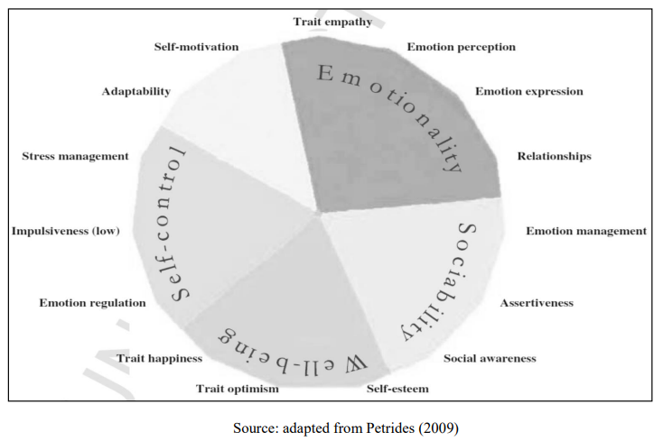
Figure 3:Trait model of emotional intelligence by Petrides

Slide 18
Studies have been proven that trait emotional intelligence as overlapping even similar to general personality factor (Van et al., 2017), although Petrides and Furnham (2001) stated that trait emotional intelligence is located at the lower levels of personality. To add on, trait emotional intelligence seems to be reframing emotional intelligence into mainstream of known Big Five personality theories. Petrides (2009, 2010) argued that emotional intelligence is a trait and not intelligence, which actually does not make sense. Intelligence as an ability to solve problems (Gardner, 1983), similarly, emotional intelligence is the ability to identify, understand, and relate of an emotion to solve problems which involves information processing and memory (Mayer, Caruso, & Salovey, 2000). Moreover, according to Horn and Cattell (1966), intelligence can be fluid (reasoning; problem-solving) or crystallised (knowledge; experience). With this aspect, fluid emotional intelligence is based on processing emotion-information; meanwhile the crystallised emotional intelligence is based on knowledge and experience (Ortony, Revelle, & Zinbarg, 2007). Additionally, Carroll (1993) stated that, in order to consider a proposed intelligence as a new domain of cognitive intelligence, it should show positive associations with the existing intelligence factors; concurrently not highly overlapped with existing intelligence.

Slide 19
In this aspect, study by Schulte, Ree, and Carretta (2004) proved that emotional intelligence is a new kind of intelligence as it moderately correlated to general intelligence (g) and the impact of general intelligence on emotional intelligence was predicted by both personality and gender. Cherniss, Extein, Goleman, and Weissberg (2006) also agreed that emotional intelligence is different from both intelligence quotient (IQ) and personality. Therefore, it clearly shows that emotional intelligence is an intelligence and not to be clustered as personality. Furthermore, intelligence increases with age (Horn & Cattell, 1966; Mayer et al., 2000). In contrast, personality trait is inborn characteristic, which persists over time and situation (Mayer & Salovey, 1997; Morris & Maisto, 2002). In fact, studies on emotional intelligence agreed that emotional intelligence increases with age (Goleman, 1995; Mayer & Salovey, 1997). Therefore, emotional intelligence should not be measured as a trait. To apply this model, it is contentious that emotional intelligence is intelligence. Hence, using this concept to evaluate emotional intelligence is incongruous and unsuitable.

